Slide 1



HCI in the software process

Slide 2
Lifecycle models
Show how activities are related to each other
Lifecycle models are:
  management tools
  simplified versions of reality
Many lifecycle models exist, for example:
  from software engineering: waterfall, spiral, JAD/RAD, Microsoft
  from HCI: Star, usability engineering

Slide 3
HCI in the software process
Software engineering and the design process for interactive systems
Usability engineering
Iterative design and prototyping
Design rationale

Slide 4
the software lifecycle
Software engineering is the discipline for understanding the software design process, or life cycle
Designing for usability occurs at all stages of the life cycle, not as a single isolated activity
Activities in life cycle
Validation and verification
Management and contractual issues
Interactive system and the software life cycle

Slide 5
The waterfall model
Requirements
specification
Architectural
design
Detailed
design
Coding and
unit testing
Integration
and testing
Operation and
maintenance

Slide 6
Activities in the life cycle
Requirements specification
  designer and customer try capture what the system is expected to provide can be expressed in natural language or more precise languages, such as a task analysis would provide
Architectural design
  high-level description of how the system will provide the services required factor system into major components of the system and how they are interrelated needs to satisfy both functional and nonfunctional requirements
Detailed design
  refinement of architectural components and interrelations to identify modules to be implemented separately the refinement is governed by the nonfunctional requirements

Slide 7
Verification and validation
Verification
  designing the product right
Validation
  designing the right product
The formality gap
  validation will always rely to some extent on subjective means of proof
Management and contractual issues
  design in commercial and legal contexts
Real-world
requirements
and constraints
The formality gap

Slide 8
The life cycle for interactive systems
cannot assume a linear
sequence of activities
as in the waterfall model
lots of feedback!
Requirements
specification
Architectural
design
Detailed
design
Coding and
unit testing
Integration
and testing
Operation and
maintenance

Slide 9
HCI life cycle model
Star
usability engineering

Slide 10
The Star lifecycle model
Suggested by Hartson and Hix
Important features:
  Evaluation at the center of activities
  No particular ordering of activities.
    Development may start in any one
  Derived from empirical studies of interface designers

Slide 11
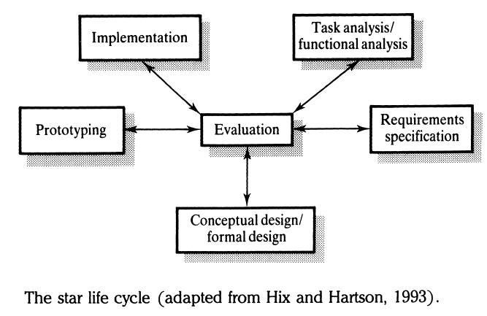
Star Lifecycle “model”

Slide 12
Usability engineering
The ultimate test of usability based on measurement of user experience
Usability engineering demands that specific usability measures be made explicit as requirements
Usability specification
  usability attribute/principle
  measuring concept
  measuring method
  now level/ worst case/ planned level/ best case
Problems
  usability specification requires level of detail that may not be
  possible early in design satisfying a usability specification
  does not necessarily satisfy usability

Slide 13
part of a usability specification for a VCR
Attribute: Backward recoverability
Measuring concept: Undo an erroneous programming
sequence
Measuring method: Number of explicit user actions
to undo current program
Now level: No current product allows such an undo
Worst case: As many actions as it takes to
program-in mistake
Planned level: A maximum of two explicit user actions
Best case: One explicit cancel action

Slide 14
ISO usability standard 9241
adopts traditional usability categories:
effectiveness
  can you achieve what you want to?
efficiency
  can you do it without wasting effort?
satisfaction
  do you enjoy the process?

Slide 15
some metrics from ISO 9241
Usability Effectiveness Efficiency Satisfaction
objective measures measures measures
Suitability Percentage of Time to Rating scale
for the task goals achieved complete a task for satisfaction
Appropriate for Number of power Relative efficiency Rating scale for
trained users features used compared with satisfaction with
an expert user power features
Learnability Percentage of Time to learn Rating scale for
functions learned criterion ease of learning
Error tolerance Percentage of Time spent on Rating scale for
errors corrected correcting errors error handling
successfully

Slide 16
Iterative design and prototyping
Iterative design overcomes inherent problems of incomplete requirements
Prototypes
  simulate or animate some features of intended system
  different types of prototypes
    throw-away
    incremental
    evolutionary
Management issues
  time
  planning
  non-functional features
  contracts

Slide 17
Prototyping Defined
Prototyping is the process of quickly putting together a working model (a prototype) in order to test various aspects of a design, illustrate ideas or features and gather early user feedback.
IEEE defines prototyping as “ A type of development in which emphasis is placed on developing prototypes early in the development process to permit early feedback and analysis in support of the development process.”

Slide 18
Need for prototyping
Enables us to explore the problem space with the stakeholders.
As a requirements artifact to initially envision the system.
As a design artifact that enables us to explore the solution space of your system.
A vehicle for you to communicate the possible UI design(s) of your system.
A potential foundation from which to continue developing the system

Slide 19
Advantages & Disadvantages of Prototyping
Advantages | Disadvantages
Users can try the system and provide constructive feedback during development | Each iteration builds on the previous iteration and further refines the solution. This makes it difficult to reject the initial solution as inappropriate and start over.
An operational prototype can be produced in weeks | Formal end-of-phase reviews do not occur. Thus, its is very difficult to contain the scope of the prototype.
Users become more positive about implementing the system as they see a solution emerging that will meet their needs | System documentation is often absent or incomplete, since the primary focus is on development of the prototype.
Prototyping enables early detection of errors | System backup and recovery, performance, and security issues can be overlooked.
Reference: http://facpub.stjohns.edu/~wolfem

Slide 20
Types of prototyping
Throw-away Prototyping
Evolutionary Prototyping
Low Fidelity Prototyping
High Fidelity Prototyping

Slide 21
Throw Away Prototype
Throw Away Prototype is developed from the initial requirements but is not used for the final project.
Written specifications of the requirements
Some developers believe that this type is a waste of time because you don’t use it.
Regardless if prototype is discarded or kept for production, you must use a easy to use language.

Slide 22
Advantages & Disadvantages
Advantages | Disadvantages
Significantly reduce project risk | The prototype actually does nothing, its just presentational.
Has a short project timeline | Only for a limited purpose
 | Starting become a thing of the past. Not getting used as much now.

Slide 23
Evolutionary Prototype
Evolutionary prototyping is consider the most fundamental form of prototyping.
Evolutionary prototyping main concept is to build a robust prototype and constantly improve it.
Objective to deliver a working system to the end user.
According to Steve McConnell, "evolutionary delivery is a lifecycle model that straddles the ground between evolutionary prototyping and staged delivery."

Slide 24
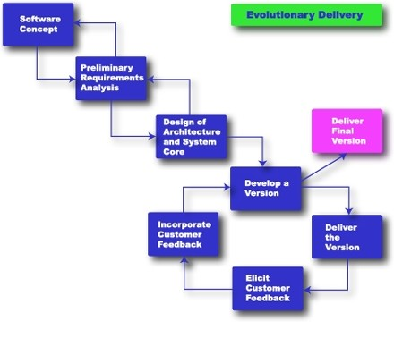
Evolutionary Delivery
Rapid Development, Taming Wild Software Schedules, by Steven McConnell, Press 1996

Slide 25
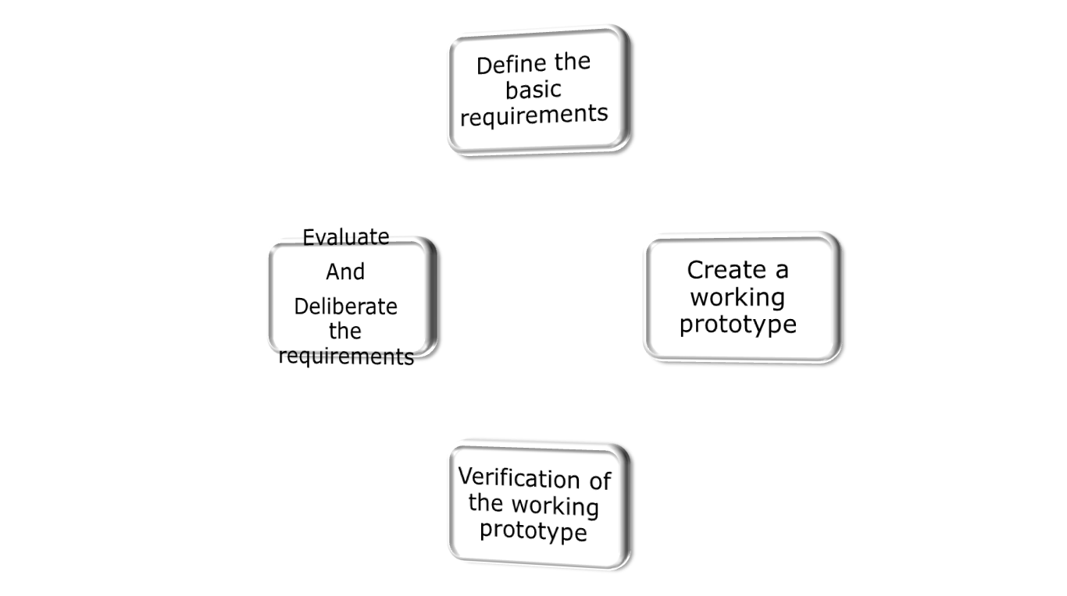
Evolutionary Prototyping phases

Slide 26
Advantages
You are always looking for new ways to improve the system.
This model increases the chance of having the client satisfied with the working system.
The model can be used even when the requirements are not defined.
Quicker delivery of the system

Slide 27
Disadvantages
This method can be used to avoid documenting the requirements of the system.
Management is required
Long term maintenance can be expensive
Uncertain design idea’s
Information can be lost through so many improvement changes

Slide 28
Low-fidelity Prototyping
Low-fidelity prototyping is generally limited function, limited interaction prototyping effort.
They are constructed to depict concepts, design alternatives and screen layouts. They are intended to demonstrate general look and feel of the interface.
They are created to educate , communicate and inform, but not to train, test or serve as a basis for which to code.
Low fidelity prototyping is used early in the design cycle to show general conceptual approaches without much investment in development.
Low vs. High Fidelity Prototyping Debate, Rudd J., Stern K.,Isensee S., ACM Interactions, Jan. 1996

Slide 29
High-Fidelity Prototyping
High-fidelity prototypes represent the core functionality of the products user interface.
High fidelity prototypes are fully interactive systems. Users can enter data in entry fields, respond to messages, select icon to open windows and interact with user interface as if it were a real system.
They trade-off speed for accuracy.
Building high fidelity prototypes consume resources and have high cost.
Low vs. High Fidelity Prototyping Debate, Rudd J., Stern K.,Isensee S., ACM Interactions, Jan. 1996

Slide 30
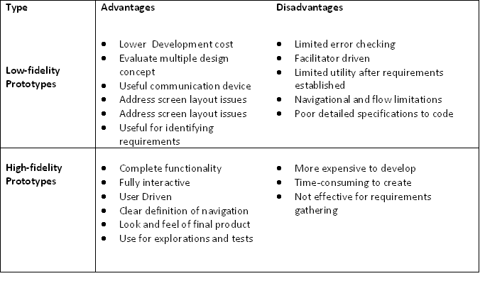
Comparison of two prototyping efforts
Low vs. High Fidelity Prototyping Debate, Rudd J., Stern K.,Isensee S., ACM Interactions, Jan. 1996

Slide 31
Techniques for prototyping
Storyboards
  need not be computer-based
  can be animated
Limited functionality simulations
  some part of system functionality provided by designers
  tools like HyperCard are common for these
  Wizard of Oz technique
Warning about iterative design
  design inertia – early bad decisions stay bad
  diagnosing real usability problems in prototypes….
  …. and not just the symptoms

Slide 32
Design rationale
Design rationale is information that explains why a computer system is the way it is.
Benefits of design rationale
  communication throughout life cycle
  reuse of design knowledge across products
  enforces design discipline
  presents arguments for design trade-offs
  organizes potentially large design space
  capturing contextual information

Slide 33
Design rationale (cont’d)
Types of DR:
Process-oriented
  preserves order of deliberation and decision-making
Structure-oriented
  emphasizes post hoc structuring of considered design alternatives
examples:
  Issue-based information system (IBIS)
  Design space analysis
  Psychological design rationale

Slide 34
Issue-based information system (IBIS)
basis for much of design rationale research
process-oriented
main elements:
  issues
    – hierarchical structure with one ‘root’ issue
  positions
    – potential resolutions of an issue
  arguments
    – modify the relationship between positions and issues
gIBIS is a graphical version

Slide 35
structure of gIBIS
supports
Position
Argument
responds to
Issue
responds to
Position
objects to
Argument
specializes
Sub-issue
generalizes
questions
Sub-issue
Sub-issue

Slide 36
Design space analysis
structure-oriented
QOC – hierarchical structure:
  questions (and sub-questions)
    – represent major issues of a design
  options
– provide alternative solutions to the question
  criteria
– the means to assess the options in order to make a choice
DRL – similar to QOC with a larger language and more formal semantics

Slide 37
the QOC notation
Criterion
Option
Question
Option
Criterion
Option
Criterion
…
Consequent
Question
…
Question

Slide 38
Psychological design rationale
to support task-artefact cycle in which user tasks are affected by the systems they use
aims to make explicit consequences of design for users
Methods
designers identify tasks system will support
scenarios are suggested to test task
users are observed on system
psychological claims of system made explicit
negative aspects of design can be used to improve next iteration of design

Slide 39
Summary
The software engineering life cycle
  distinct activities and the consequences for interactive system design
Usability engineering
  making usability measurements explicit as requirements
Iterative design and prototyping
  limited functionality simulations and animations
Design rationale
  recording design knowledge
  process vs. structure

